Slide 1




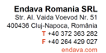
Basic C# part 4
Teodora Berende
Proiect cofinantat din Fondul Social European prin Programul Operational Capital Uman 2014-2020

Slide 2


AGENDA
Source code formatting
Identifiers
Conventions
SOLID (just mentioned)
Single responsibility applied on functions
String builder
Proiect cofinantat din Fondul Social European prin Programul Operational Capital Uman 2014-2020

Slide 3

Source code formatting
Proiect cofinantat din Fondul Social European prin Programul Operational Capital Uman 2014-2020

Slide 4
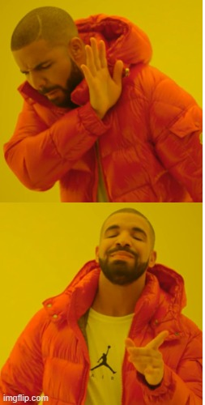
List<int> numbers = new List<int> { 1, 2, 3 };
foreach(var number in numbers){
Console.WriteLine(number);}
List<int> numbers = new List<int> { 1, 2, 3 };
foreach(var number in numbers)
{
Console.WriteLine(number);
}
Proiect cofinantat din Fondul Social European prin Programul Operational Capital Uman 2014-2020

Slide 5
Source code formatting
Format Document
Format Selection
Shift+Alt+F
Format the entire active file.
Ctrl+K Ctrl+F
Format the selected text.
Proiect cofinantat din Fondul Social European prin Programul Operational Capital Uman 2014-2020

Slide 6

Identifiers
Proiect cofinantat din Fondul Social European prin Programul Operational Capital Uman 2014-2020

Slide 7
Identifiers
The name for a
variable
method
class.
Must begin with a letter or underscore ( _ )
Can’t contain symbols such as ? - + ! @ # % ^ & * ( ) [ ] { } . ; : " ' / and \.
It can’t be a C# keyword such as for, if, class, public, etc.
Proiect cofinantat din Fondul Social European prin Programul Operational Capital Uman 2014-2020

Slide 8

Conventions
Proiect cofinantat din Fondul Social European prin Programul Operational Capital Uman 2014-2020

Slide 9
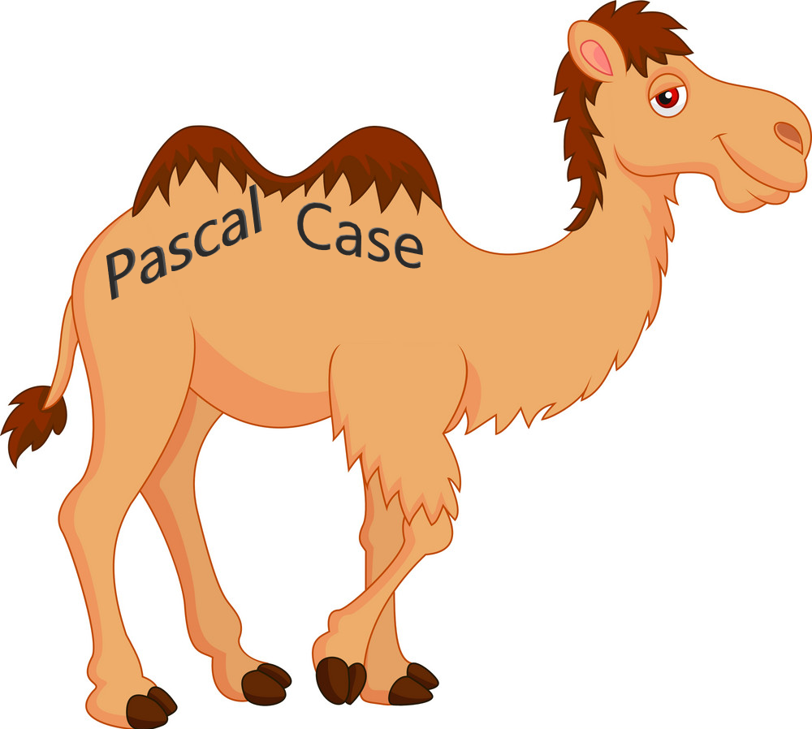

PascalCase vs camelCase
Proiect cofinantat din Fondul Social European prin Programul Operational Capital Uman 2014-2020

Slide 10
PascalCase vs camelCase
Classes
Public variables in a class
Methods
PUBLIC resource
Private variables in a class
Variables inside of a method
PRIVATE resource
Proiect cofinantat din Fondul Social European prin Programul Operational Capital Uman 2014-2020

Slide 11
if(number%2 == 0) //check number is even
{
Console.WriteLine("Number is even.");
}
//check number is even
if(number%2 == 0)
{
Console.WriteLine("Number is even.");
}
Proiect cofinantat din Fondul Social European prin Programul Operational Capital Uman 2014-2020

Slide 12
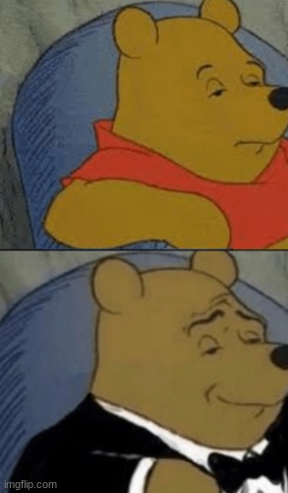
VAR
var phrase = GetPhrase();
var number = Convert.ToInt32(Console.ReadLine());
var phrase = "This is clearly a string.";
var number = 27;
string phrase = GetPhrase();
int number = Convert.ToInt32(Console.ReadLine());
Proiect cofinantat din Fondul Social European prin Programul Operational Capital Uman 2014-2020

Slide 13
Practice TIME
Source code formatting
Identifiers
Conventions
Proiect cofinantat din Fondul Social European prin Programul Operational Capital Uman 2014-2020

Slide 14
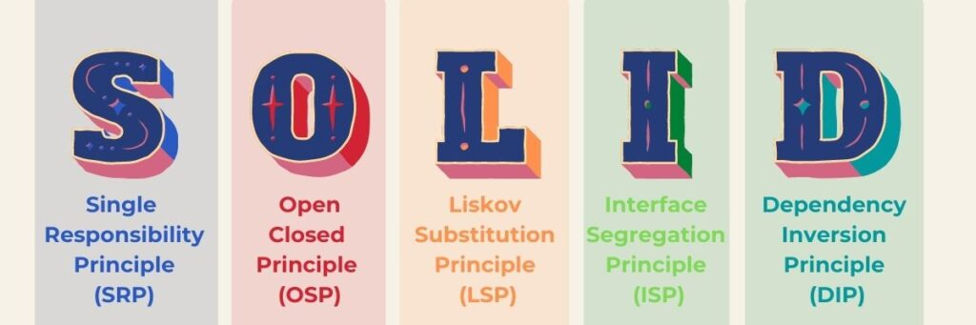
Proiect cofinantat din Fondul Social European prin Programul Operational Capital Uman 2014-2020

Slide 15

Single responsibility applied on functions
Proiect cofinantat din Fondul Social European prin Programul Operational Capital Uman 2014-2020

Slide 16
Every class, module, or method in a program should have one responsibility/purpose in a program.
“Every class/method should have only one reason to change."
Proiect cofinantat din Fondul Social European prin Programul Operational Capital Uman 2014-2020

Slide 17
Practice TIME
Single responsibility applied on functions
Proiect cofinantat din Fondul Social European prin Programul Operational Capital Uman 2014-2020

Slide 18

String builder
Proiect cofinantat din Fondul Social European prin Programul Operational Capital Uman 2014-2020

Slide 19
String
Immutable => once you create a string, you cannot modify it.
Performance degrades when heavy modifications are applied such as concatenation, because it creates a new instance with each change.
Thread-safe.
StringBuilder
Mutable => you can modify it.
Better performance on modifying the string because the changes are made to the existing instance instead of creating the new one in the memory.
Not thread-safe
Proiect cofinantat din Fondul Social European prin Programul Operational Capital Uman 2014-2020

Slide 20
String
If you only need to read or compare strings, you should use a string.
StringBuilder
If you need to build or modify a string repeatedly, you should use a StringBuilder.
Proiect cofinantat din Fondul Social European prin Programul Operational Capital Uman 2014-2020

Slide 21
Practice TIME
String builder
Proiect cofinantat din Fondul Social European prin Programul Operational Capital Uman 2014-2020

Slide 22
Q&A
Proiect cofinantat din Fondul Social European prin Programul Operational Capital Uman 2014-2020

Slide 23

THANK YOU
Teodora Berende
teodoraemilia.berende@endava.com
Proiect cofinantat din Fondul Social European prin Programul Operational Capital Uman 2014-2020

